Slide 1





Introduction to Robotic Process Automation
CLINIC ALERT EMAIL
Your Register No. 220701130
Name : J KHARTHIK
Guide Name :Mrs. J. JINU SOPHIA
Designation and Department : B and CSE

Slide 2
Abstract
The CLINIC ALERT EMAIL project aims to streamline clinic operations by automating appointment reminders. Using UiPath, the solution reads customer details from an Excel sheet, verifies appointment dates, and identifies those occurring within the next three days. Automated email alerts are then sent to these customers, ensuring timely reminders. This approach reduces manual effort, minimizes missed appointments, and enhances customer satisfaction. The bot seamlessly integrates with existing systems, enabling real-time processing and accurate communication. By automating repetitive tasks, this project contributes to operational efficiency and allows clinic staff to focus on patient care and other strategic priorities.

Slide 3
Need for the Proposed System
The proposed Clinic Alert Email system addresses the need for efficient and automated appointment reminder management in healthcare settings. With increasing patient volumes and the complexity of managing appointments, manual reminder processes can lead to errors, missed appointments, and decreased operational efficiency. The system leverages Robotic Process Automation (RPA) to automatically extract appointment data from Excel, identify appointments nearing the scheduled date, and send personalized email reminders. By automating these tasks, the system reduces administrative burden, ensures timely communication, and improves patient engagement, ultimately contributing to better clinic management and patient satisfaction.

Slide 4
Advantages of the Proposed System
Increased Efficiency: Automates appointment reminder process, reducing manual effort.
Improved Patient Engagement: Ensures timely and personalized reminders.
Cost-Effective: Reduces administrative costs by automating routine tasks.
Reliability: Includes error handling to ensure smooth operation.
Data Accuracy:Ensures accurate tracking and validation of appointment data.
Scalability: Can handle increasing appointments and adapt to clinic needs..

Slide 5
Main Objective
The main objective of the Clinic Alert Email system is to automate the process of sending timely and personalized appointment reminders to patients, ensuring improved patient engagement, reducing no-shows, and enhancing operational efficiency by eliminating manual efforts in tracking and notifying appointments.

Slide 6
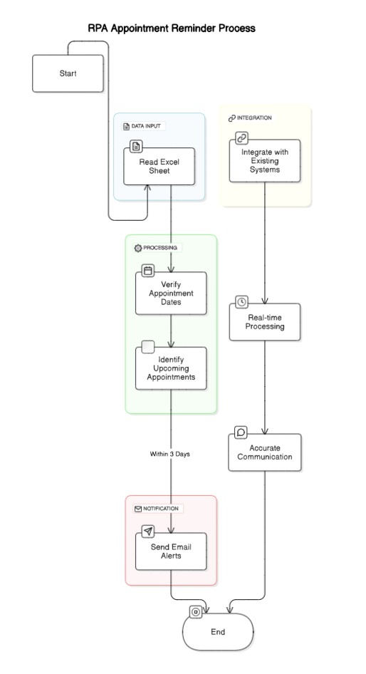
Architecture
Input Layer: Receives patient data and appointment details stored in an Excel file.
Processing Layer: Extracts and validates the data for accuracy.
Logic Layer: Identifies appointments scheduled within the next 3 days.
Action Layer: Generates personalized email reminders and sends them via email service.
Error Handling & Logging: Monitors for issues and logs errors to ensure reliable operation.
Output Layer: Successfully delivers reminder emails to patients.

Slide 7
System Requirements
Hardware:
Processor: Intel Core i3 or higher
RAM: 4 GB minimum, 8 GB recommended
Storage: 100 GB free space (SSD recommended)
Display: 1366 x 768 resolution minimum
Internet: Required for cloud services
Software:
UiPath Studio: Latest version
Microsoft Excel: 2016 or higher
Microsoft Outlook (for email notifications)
Operating System: Windows 10 or higher (64-bit)
SQL Database (optional for data management)
Additional Tools:
UiPath.Mail.Activities, UiPath.Excel.Activities, UiPath.Database.Activities (for email, Excel, and database operations)

Slide 8
Functional Description
Data Extraction and Validation
This module is responsible for extracting patient and appointment data from an Excel file, ensuring the data is accurate and complete. It performs data validation to check for missing or incorrect information. After validation, the system filters out appointments that are scheduled within the next three days, creating a list of patients who need reminder emails. This ensures that only the relevant appointments are processed, improving efficiency and reducing the risk of errors.
Process: The system extracts patient and appointment data from an Excel file, validates the data for accuracy, and filters out appointments scheduled within the next three days.
Data Flow: Excel File → Data Extraction → Data Validation → Filtered Appointments → Identified Patients for Reminders.
External Entities: Clinic staff (for data management), patients (for receiving reminders).
Email Generation and Notification:
This module generates personalized email reminders for patients based on the filtered appointment data. It automatically sends the emails via an email service (SMTP/Outlook) and handles error logging in case of issues like invalid email addresses or failed deliveries..
Process: Generate and send personalized email reminders, log errors if any.
Data Flow: Validated Data → Email Generation → Email Delivery → Error Logs.
External Entities: IT staff, patients.

Slide 9
Process Design
Main Process:
Extract Patient Data: Retrieve appointment details from the Excel sheet for patients with upcoming appointments in the next 3 days.
Validate Data: Check if the email reminder has already been sent by verifying the "Email Status" column.
Send Reminder: Send email notifications to patients and update their status in the table.
Log Errors: Capture and log any errors (e.g., invalid emails) for review.
Generate Report: Create a summary report on sent notifications and failed attempts.
Subprocesses:
Data Extraction: Retrieve patient info from Excel.
Data Validation: Ensure email hasn't been sent.
Error Handling: Log failed email attempts.
Report Generation: Create a summary report.

Slide 10
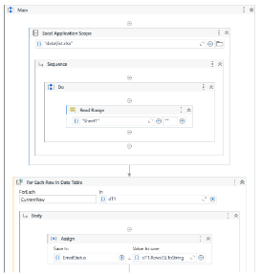
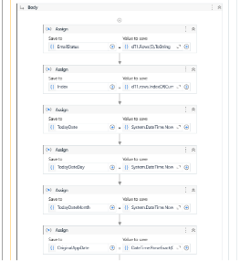
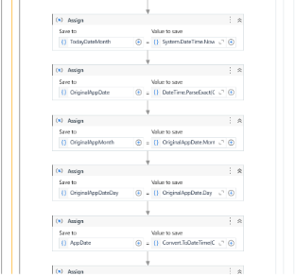
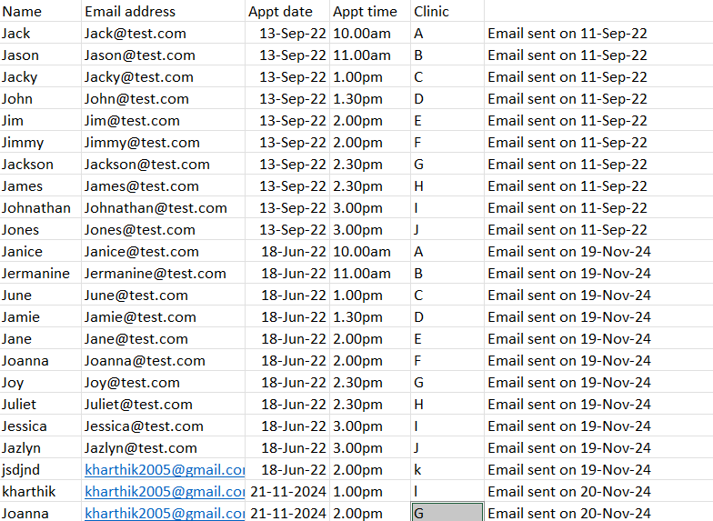
Implementation
Data Extraction and Validation
Module 1 focuses on extracting patient data from the Excel sheet, which includes names, emails, and appointment dates. It then validates if the appointment is within the next 3 days and ensures that an email has not already been sent to the patient. This module interacts with the Excel file to fetch and validate data.
Email Notification and Logging
Module 2 handles the sending of email reminders to patients whose appointments are nearing. After sending the email, it updates the Excel sheet to mark the email status as sent. Additionally, any errors encountered (such as invalid email addresses) are logged for troubleshooting. This module interacts with the email server and the Excel file to ensure accurate email delivery and status updates.

Slide 11
Testing
Testing:
Unit Testing: Test individual modules and verify correct handling of email statuses.
Integration Testing: Ensure data flows seamlessly between modules (Excel, email server).
Functional Testing: Test sending emails for appointments within 3 days.
Performance Testing:Test system response under heavy data loads.
Regression Testing:Retest after updates to ensure no existing functionality is broken.

Slide 12
Conclusions
The Clinic Appointment Alert Email system successfully automates the process of sending timely appointment reminders to patients, ensuring improved communication and reduced manual effort. By leveraging data extraction, email automation, and error logging, the system enhances operational efficiency and accuracy. With thorough testing to verify functionality and performance, the solution meets its objectives of providing reliable, automated email notifications, while offering scalability for future improvements.

Slide 13
Future Enhancement
Personalization of Emails:
Implement dynamic email templates to personalize messages based on patient information (e.g., name, appointment details). This will improve user engagement and provide a more tailored experience for patients.
Cross-Platform Notification Integration:
Expand the notification system to include SMS or mobile app notifications, allowing patients to receive reminders through multiple communication channels, enhancing accessibility and reliability of the system.

Slide 14
References
References (Short)
UiPath Documentation: Official UiPath documentation for automation tasks and activities. [https://docs.uipath.com](https://docs.uipath.com)
Excel Data Handling: Microsoft Excel support for automation tasks such as reading and writing data. [https://support.microsoft.com/excel](https://support.microsoft.com/excel)
Outlook Integration with UiPath: UiPath documentation for integrating Outlook for sending emails. [https://docs.uipath.com/activities/docs/send-outlook-mail-message](https://docs.uipath.com/activities/docs/send-outlook-mail-message)
Entity Relationship Diagram (ERD): General principles and guidelines for designing an ERD. [https://www.lucidchart.com/pages/er-diagrams](https://www.lucidchart.com/pages/er-diagrams)

Slide 15
Thank You

